Slide 1
Introduction to Databases
CT042-3-1-IDB
Introduction & Module Overview

Slide 2
Lecturer information
Lecturer Name: Mr. Paras Mishra
Email: paras.mishra@cps.edu.np

Slide 3
Pre-requisites for this module
None

Slide 4
Aims of this module
This module introduces the students to the fundamental characteristics of database management systems with a data model such as relational data model.
The module relies on design and implemenation of database environment.

Slide 5
Course Learning outcomes, CLOs
At the end of this course, YOU should be able to:
State an overview of the field of database management systems.
Explain the basic concepts and principles behind the working of database management systems
Demonstrate a database solution for specific problems .

Slide 6
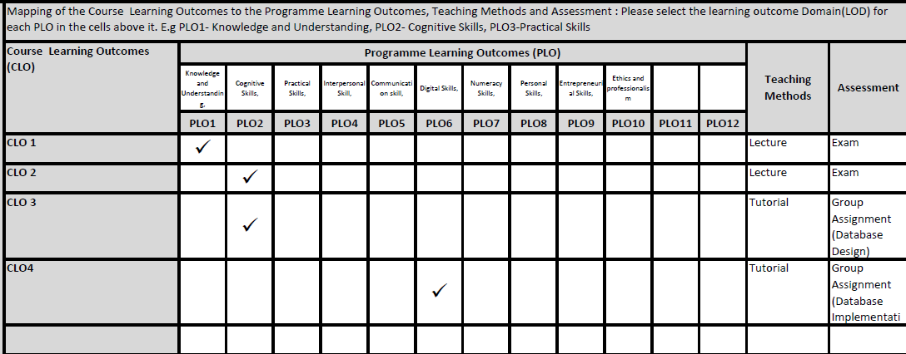
Mapping of CLOs
PLO1 – Knowledge
PLO3 – Critical Thinking and Scientific Skills
PLO5 – Social Skills, Teamwork and Responsibilities

Slide 7
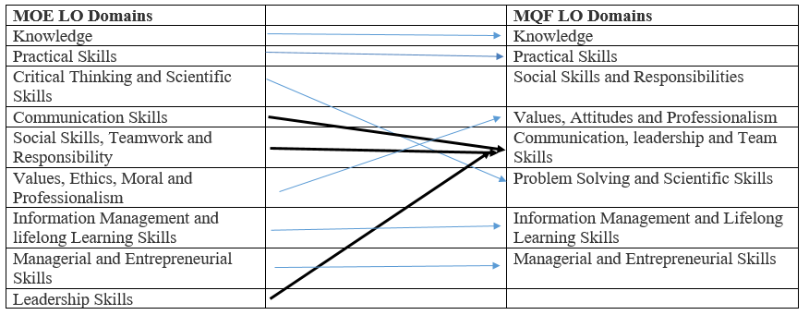
MQF and MOE Domains

Slide 8
Teaching Strategies
Lecture
Tutorial
Case Study (Individual and Group)

Slide 9
Assessment Methods
Final Exam (50%) : CLO1 & CLO2
Group Assignment (50%): CLO3 & CLO4

Slide 10
Student Learning Time (SLT)
Course Credit Value: 3
Total Learning Hours:
Lecture: 31.5 hours per semester
Tutorial / Case Study : 21 hours per semester
Independent Learning Time: 68 hours

Slide 11
Methods of Delivery
Hence,
We are now moving from the traditional topic based teaching to outcome-based education

Slide 12
Outcomes Based Education (OBE)
OBE is education based on producing particular educational outcomes that:
Focus on what students can actually do after they are taught
Expect all learners / students to successfully achieve particular (sometimes minimum) level of knowledge and abilities.

Slide 13
So…What is OBE?
It’s
NOT
What we want to teach,
It’s
What You should learn

Slide 14
Course Content Outline
CLO1 & CLO2 : Final Exam (50%)
Lecture
Introduction to Database
Database System Concepts & Architecture
Data Modelling Using Entity Relationship Model
Enhanced ER and Object Modelling
Database Design
Relational Database Design
Database Management using SQL Server / Oracle
Structured Quary Language
Normalization
Practical Database Design and Tuning

Slide 15
Course Content Outline
CLO3 & CLO4 : Group Assignment (50%)
Tutorial / Case Study
Design a database solutions: -Modelling Entity Relationship Diagram
Implement database solutions Part1:-Implement database with SQL-Manipulate tables with DML
Implement database solutions Part2:-Defining tables with DDL-Mapping ERD with relational schema

Slide 16
What is expected of you
What is expected of you
You should abide to all the rules & regulation of APU
Proper attire
No speaking of dialects
Attendance is compulsory and valid medical certificates or letters from parents /guardians must support any absence from class.
Three lateness will be equal to one absence
All pagers and handphones should be turned off during lectures.

Slide 17
What support is available for you
Consultation hours
Resources
Reference material
Essential Reading
Coronel, C., Morris, S. (2018). Database Systems: Design, Implementation, & Management. 13th ed. Course Technology. ISBN-13: 978-1111969608
M. Kroenke, D., J. Auer, D., L. Vandenberg, S., Yoder, R.C. (2017). Database Concepts. 8th ed. Pearson. ISBN:9780134601694
Harrington, J. (2016). Relational Database Design and Implementation. 4th ed. Morgan Kaufmann. ISBN: 9780128043998
Internet resources
Software : Ms.SQL Server, Ms.Visio

Slide 18
Software used
Ms.SQL Server
Ms.Visio (Optional)
Can use online tools as alternative, such as: Draw.io, Lucidchart, Smartdraw

Slide 19
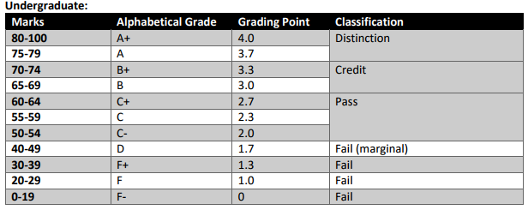
Achievement requirements

Slide 20
Question and Answer Session
Q & A

Slide 21
What we will cover next
Data vs Information
Data is raw, unprocessed facts and figures without context (e.g., numbers, dates, or text).
Information is processed, organized, or structured data that is meaningful and useful for decision-making.
Example:
Data: "45, 67, 89" (just raw numbers).
Information: "The average score of the class in the math exam is 67" (processed data that provides meaning).

Slide 22
Flat file vs DBMS
Flat File:
Stores data in a simple, unstructured format like text or CSV files.
Limited to basic storage without advanced querying, relationships, or multi-user access.
Example: A CSV file storing employee data with columns like "Employee ID, Name, Department." Data is hard to link to other files or run complex queries.
DBMS (Database Management System):
Stores data in a structured way, often in tables, and supports relationships between data.
Offers advanced features like querying, data integrity, security, and multi-user access.
Example: A relational database with tables for "Employees" and "Departments," linked by a "Department ID." You can run complex queries to retrieve data across multiple tables efficiently

Slide 23
1. Data Redundancy and Consistency
Flat File System: Data redundancy (duplicate data) can occur easily, leading to inconsistencies since each file operates independently without relationships.
DBMS: DBMS uses normalization techniques to reduce redundancy. Relationships and constraints ensure that data is consistent across the database, minimizing duplication.
2. Data Integrity
Flat File System: It’s difficult to enforce data integrity rules in a flat file, meaning data may be entered in an inconsistent or incorrect format.
DBMS: DBMS enforces integrity constraints (like unique keys, foreign keys, and validation rules) to ensure that data is accurate and relia
3. Data Security
Flat File System: Flat files have limited security features, relying mostly on file permissions, which are often insufficient for complex applications.
DBMS: DBMS provides multiple layers of security, including user roles, permissions, and access control at various levels (e.g., table, row, column) to restrict unauthorized access and modifications.
4. Concurrent Access and Data Isolation
Flat File System: Concurrent access is difficult because multiple users accessing the same file can cause conflicts, leading to data corruption.

Slide 24
3. Data Security
Flat File System: Flat files have limited security features, relying mostly on file permissions, which are often insufficient for complex applications.
DBMS: DBMS provides multiple layers of security, including user roles, permissions, and access control at various levels (e.g., table, row, column) to restrict unauthorized access and modifications.
4. Concurrent Access and Data Isolation
Flat File System: Concurrent access is difficult because multiple users accessing the same file can cause conflicts, leading to data corruption.
DBMS: DBMS uses transaction management and locking mechanisms to allow multiple users to access and manipulate data simultaneously without conflicts, ensuring data consistency and isolation.

Slide 25
7. Data Relationships
Flat File System: There is no inherent way to define and manage relationships.
DBMS: DBMS supports relational structures where data can be organized in tables with defined relationships (e.g., primary and foreign keys), making it easy to manage and retrieve interconnected data.
8. Efficiency in Data Processing
Flat File System: Processing data in flat files is generally slow, especially for operations like searching, updating, or deleting records.
DBMS: DBMS uses indexes, optimized storage, and query planning to make data processing more efficient and scalable.
While flat file systems are suitable for small, simple data storage needs, DBMS is essential for applications requiring complex data management, reliability, security, and efficiency. DBMS offers a robust environment for managing and manipulating data, making it far more suitable for modern, large-scale applications than flat file systems.

